Slide 1
WHAT IS GARFIELD DOING?

Slide 2
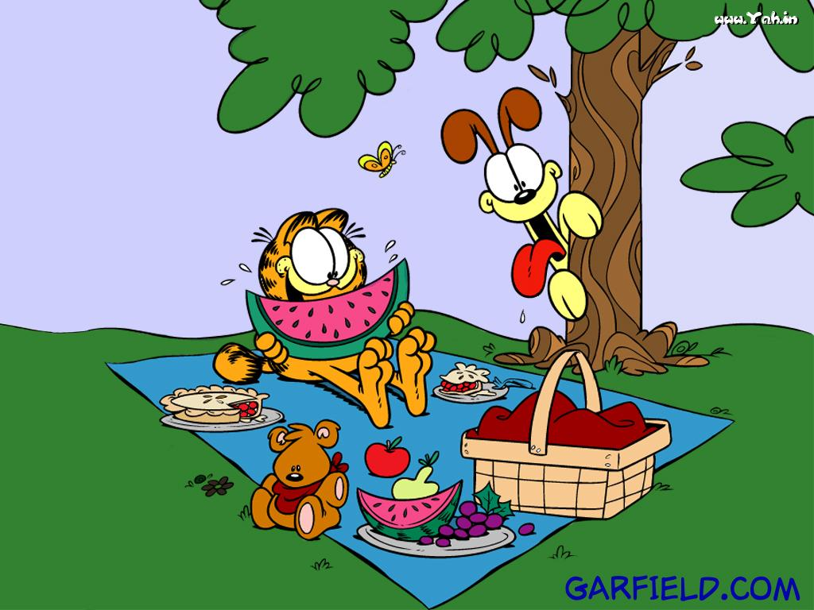

Slide 3
HE IS EATING

Slide 5
HE IS PLAYING BASKETBALL

Slide 7
HE IS SLEEPING

Slide 8
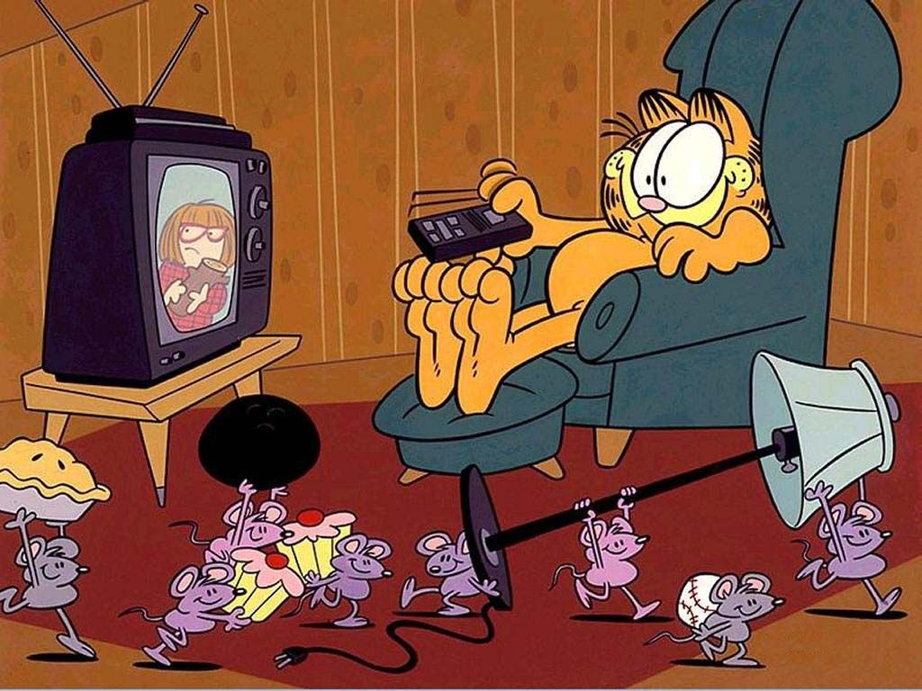

Slide 9
HE IS WATCHING TV

Slide 11
HE IS DRINKING COFFEE

Slide 13
HE IS DRIVING A CAR

Slide 15
HE IS READING A BOOK

Slide 16
GOODBYE!!!

