Slide 1
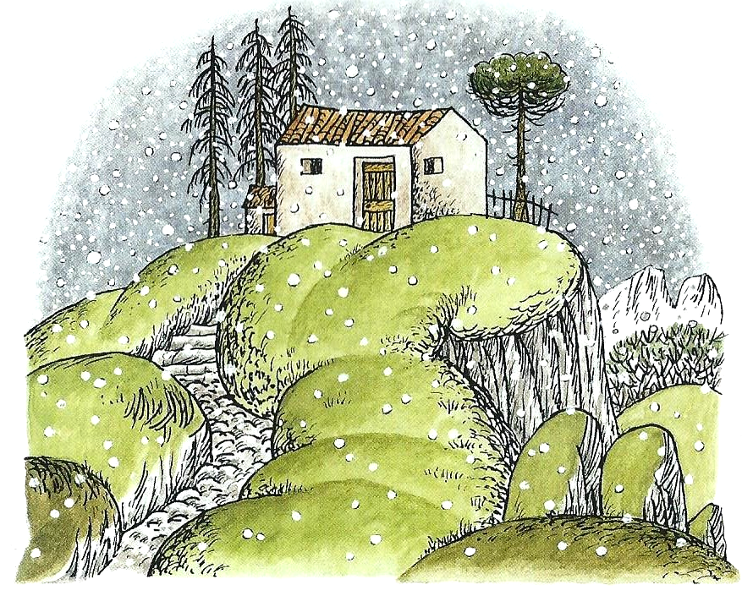
THE TWELVE UNCLES

Slide 2
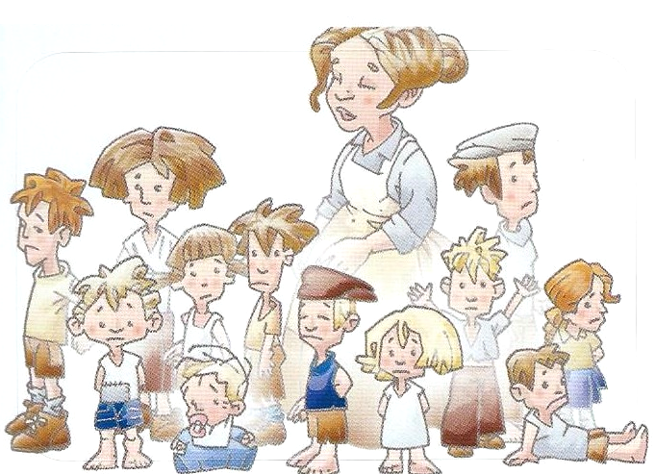
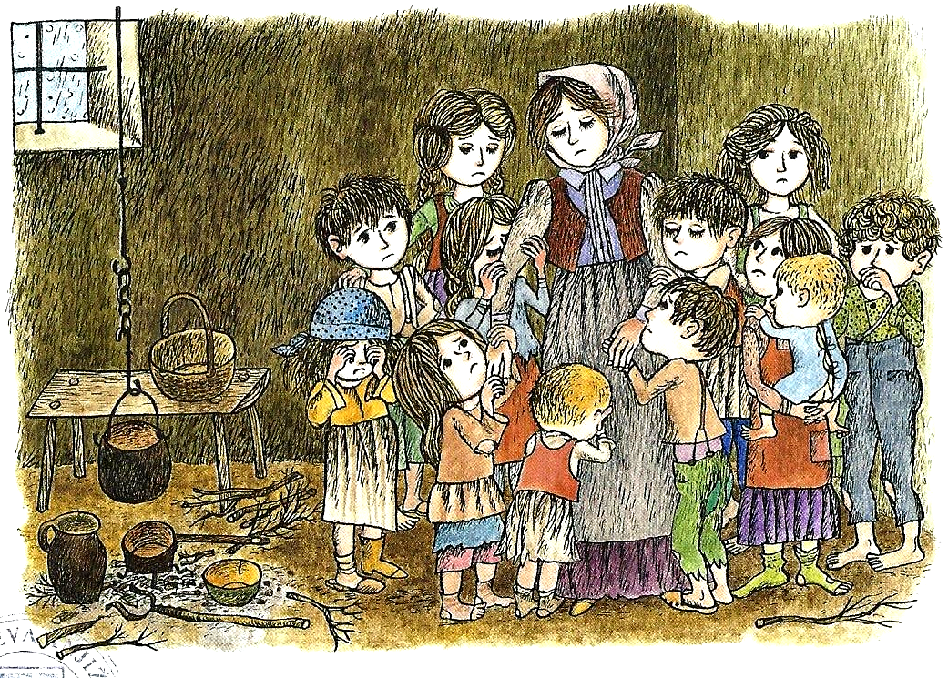
Once upon a time there was a woman, who had twelve children. Their father died and they were very poor. They had no nice clothes and were often very hungry.
Every day the children cried: „Mummy, Mummy, please, buy something for us.“
Their mother didn‘t know what to do. Then she remembered: „ I‘ve got twelve uncles. I‘lll go and visit them. Maybe they can help us.“
One snowy day in winter she put on her sandals and set off into the cold.

Slide 3
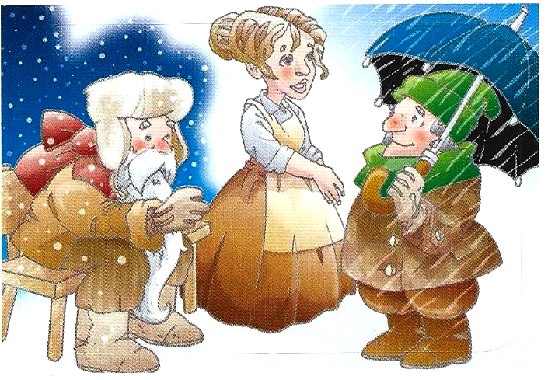
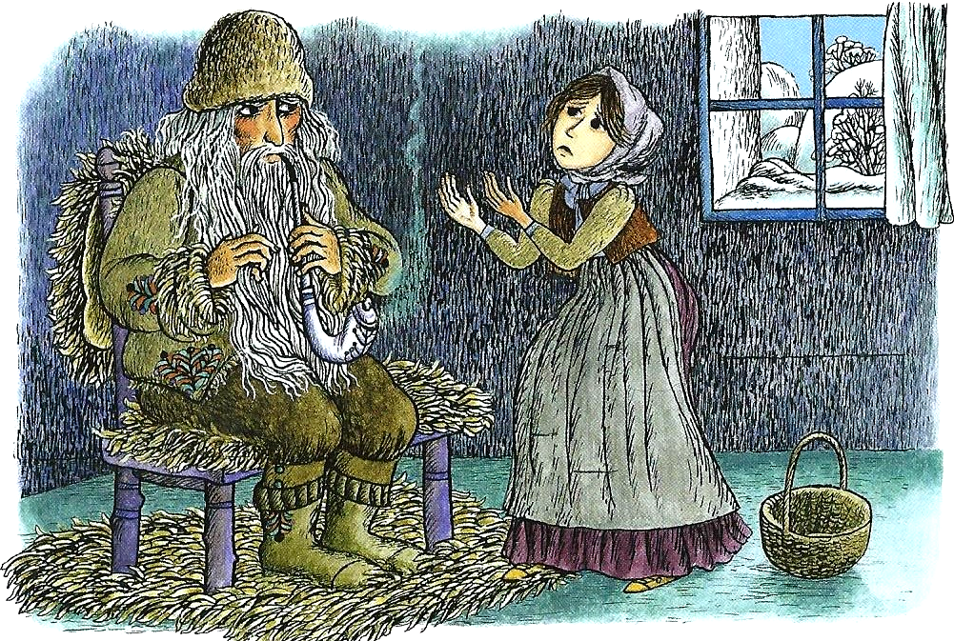
She came to the first uncle – JANUARY. He had a red face, a long beard and white hair. „Good morning, unlce January,“ she greeted him. „Good morning. What are you doing here?“ he asked.
„I live all alone with my twelve children. They‘ve only got old clothes and are often very hungry. Please, help us.“
I‘m sorry,“ said unlce January. „It‘s winter. All I have got is snow. I can‘t give you anything. Go and visit my brothers.“

Slide 4
She walked and walked and came to the nex uncle – FEBRUARY. He was short but very smart and funny.
„Hello, uncle February,“ she said. „Hello. Where are you going, my dear?“
„I live all alone with my twelve children. They‘ve only got old clothes and are often very hungry. Please, help us.“
„I‘m sorry. All I‘ve got is rain and wind. I can‘t give you anything. Go and visit my brothers.“

Slide 5
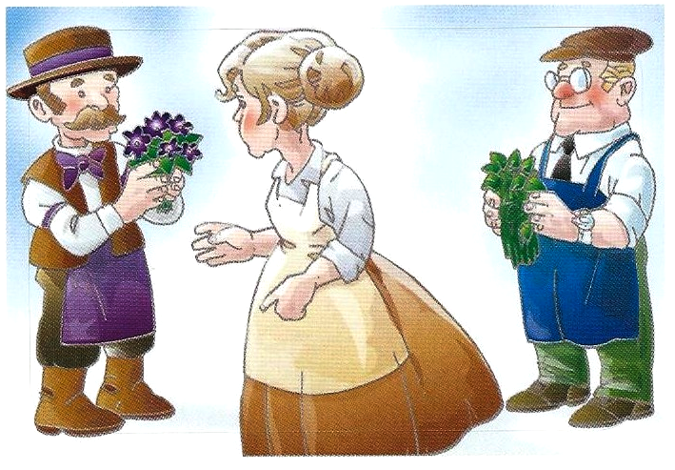
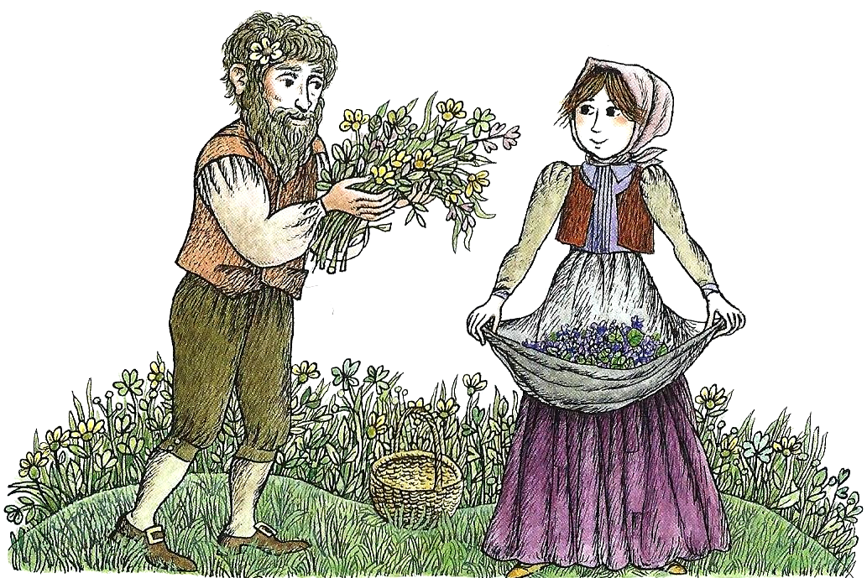
The mother was very sad. She was cold and wet and she walked and walked and came to uncle MARCH.
„Good afternoon, uncle March,“ she said. „Good afternoon. What are you doing here?“ he asked.
„I live all alone with my twelve children. They‘ve only got old clothes and are often very hungry. Please, help us.“ „Oh, dear. It‘s spring but it‘s still cold and windy. Wait here, I‘ll have a look.“ The mother sat down and waited sadly. But soon uncle march came back with sweet-smelling violets. The mother was happy. She thanked him and went on to visit uncle APRIL. She explained him situation and showed him the violets. „Wait here,“ said uncle April, „I will give you something.“ He came back with some bursting tree shoots.

Slide 6
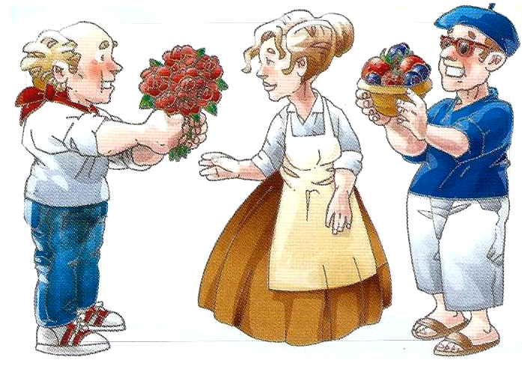
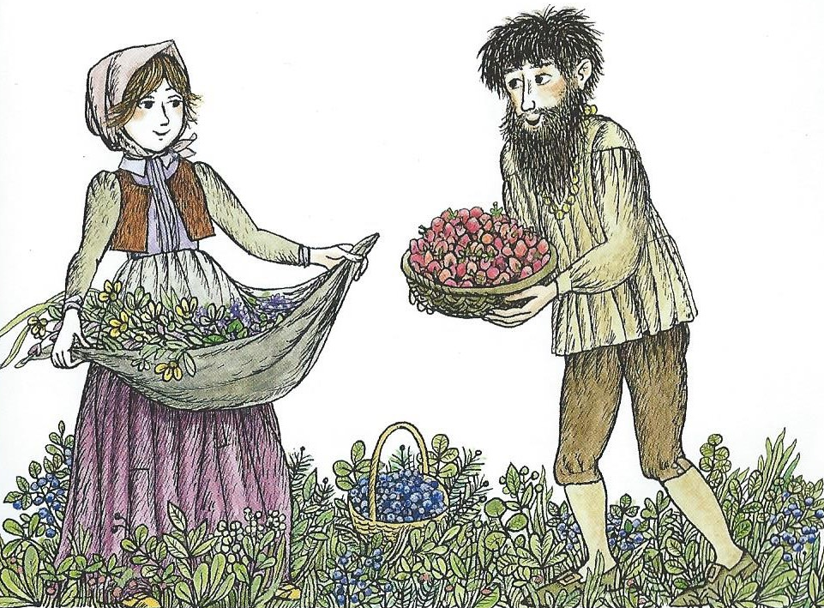
Then she came to uncle MAY. „Please, give me something for my children,“ she asked. Uncle May gave her a bunch of beautiful red flowers.
The mother said: „Thank you very much,“ and went on to see uncle JUNE.
It was a hot summer day, so uncle June picked some raspberries and blueberries for the mother and her children. She thanked him and went on happily.

Slide 7
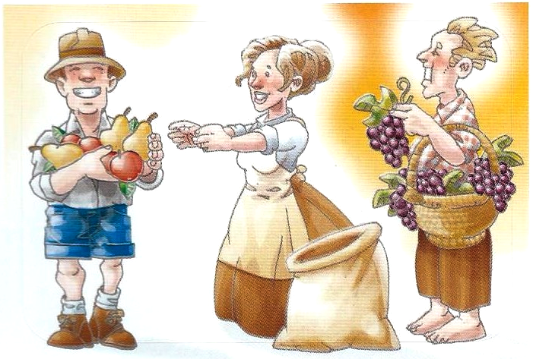
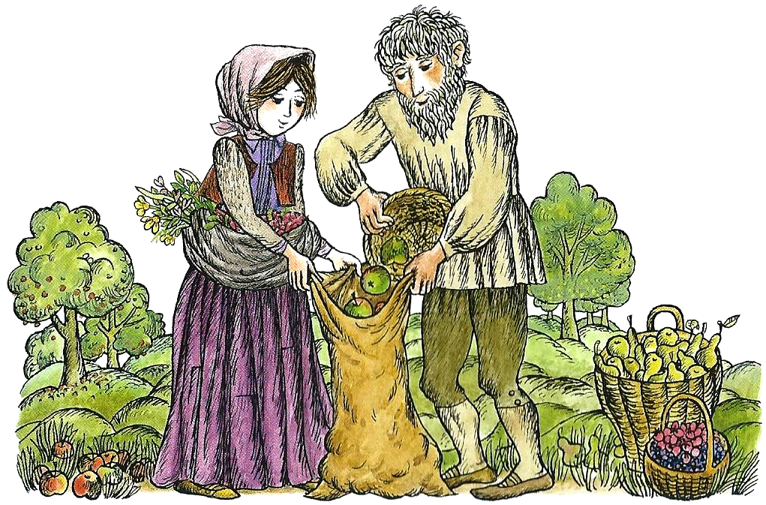
Then she visited uncle JULY and told him about her family. Uncle July gave her some appples and pears and bags to put all the food in. The mother was happy. She was carrying a bunch of violets, green tree shoots, raspeberries and blueberries and apples and pears.
She went on to uncle AUGUST who gave her lots of grapes.

Slide 8
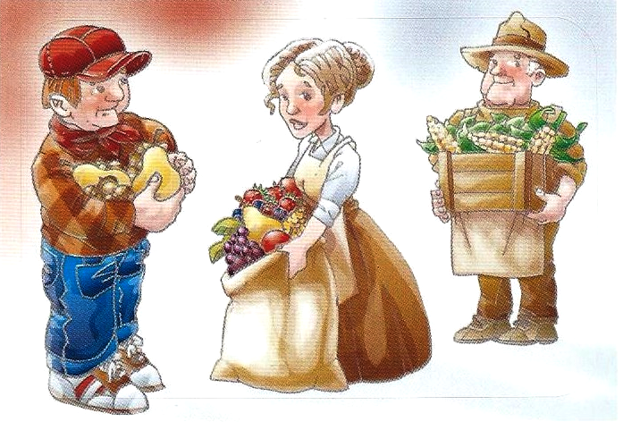
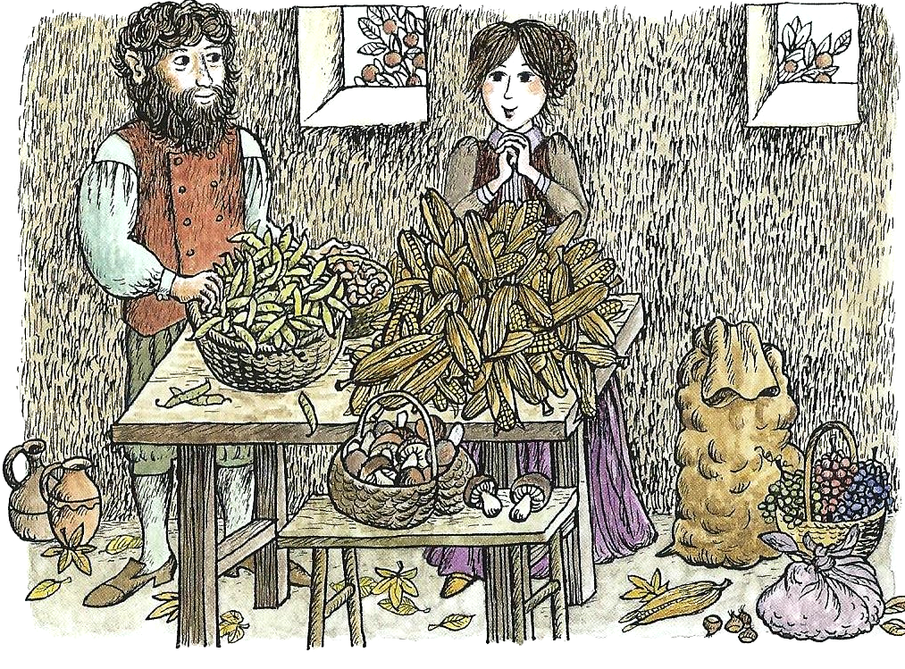
Then she went to visit uncle SEPTEMBER. He gave her lots of pears and chesnuts.
Then she went to uncle OCTOBER. „Here you are,“ he said and gave her a lot of maize and beans.

Slide 9
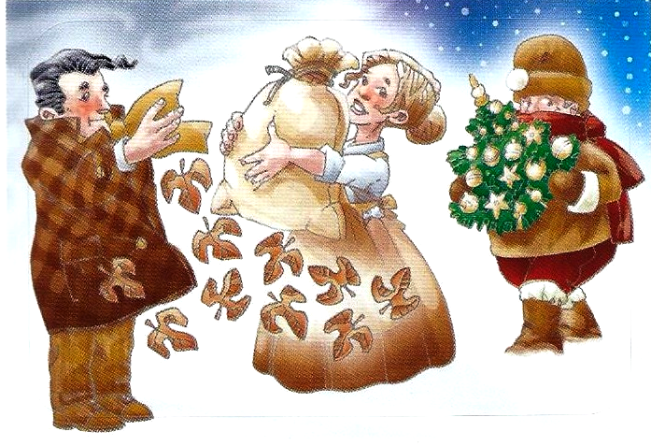
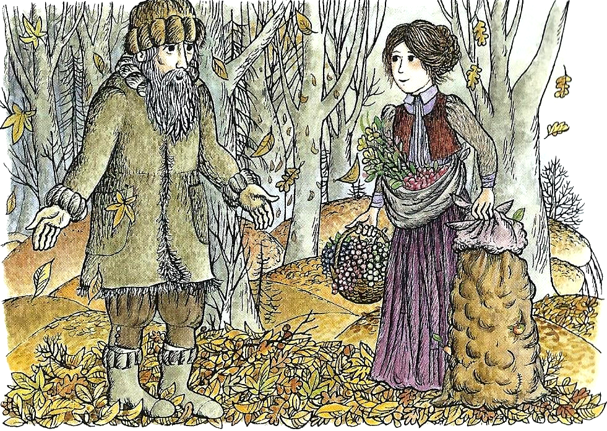
Then she visited unlce NOVEMBER. He told her that at the end of autumn he only had beautiful leaves on the ground.
So the mother went on to say hello to uncle DECEMBER.
He promised to bring her children some candies for the forthcoming Christmas.

Slide 10
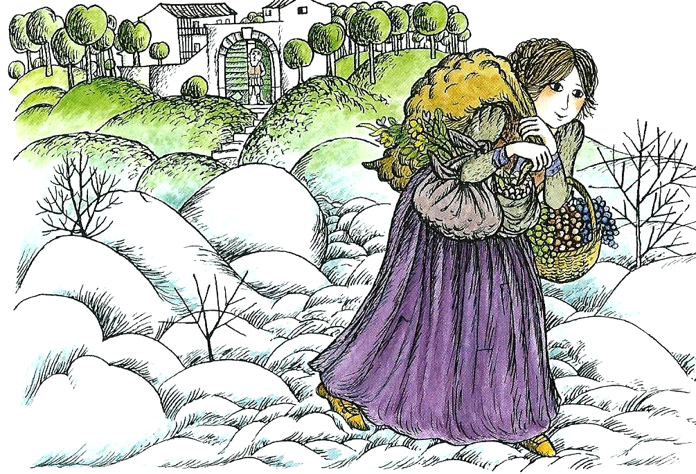
The mother thanked him and went home happily.

Slide 11
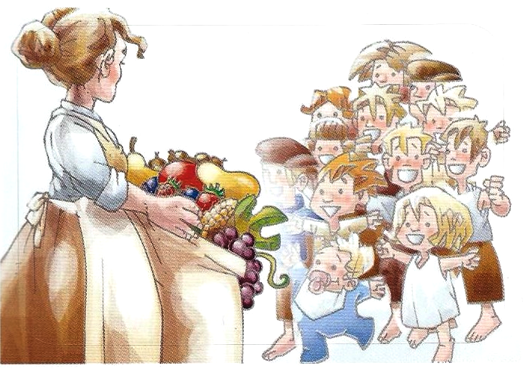
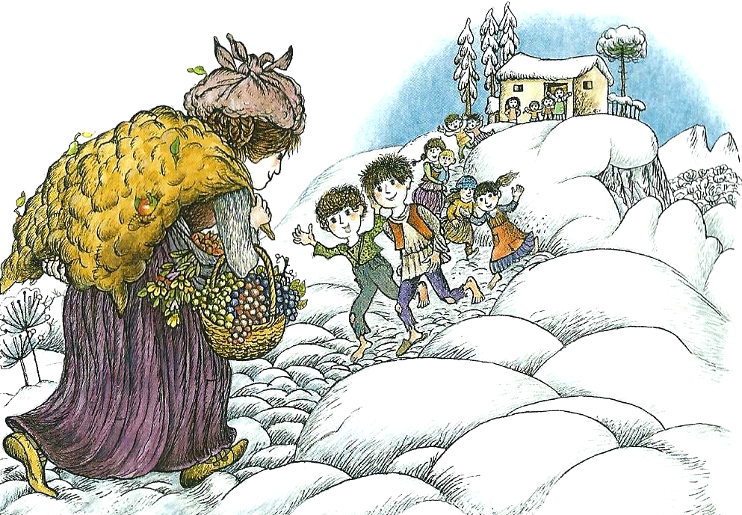
„Good evening, children. Look what I‘ve got for you. Be happy.“ she smiled.
„Mummy, Mummy,“ the children ran towards her, hugging and kissing her happily.

Slide 12
THE END

